Slide 1

Software Defined Mobile Load Balancing (MLB) in LTE & 5G Networks
A. Kumar, T. Manna, S. Parekh*, R. Ravindran, K. Tang
Sterlite Technologies Limited (STL)
*corresponding author (shyam.parekh@sterlite.com)

Slide 2
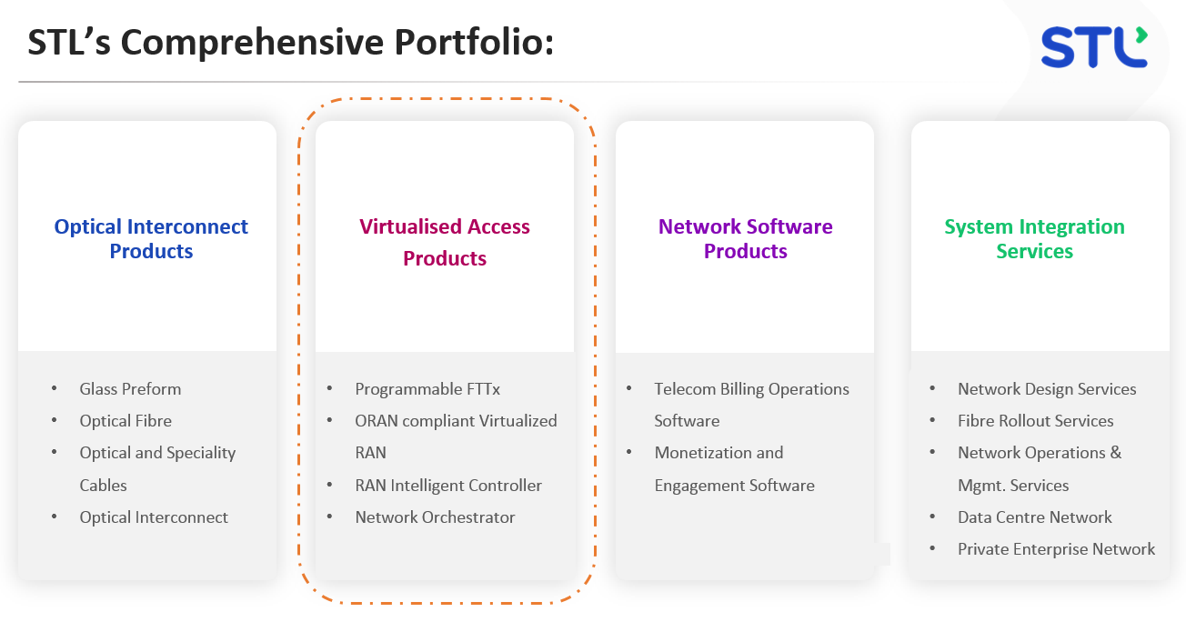

Slide 3
Mobile Load Balancing
Our NS-3 Implementation:
Based on LTE’s Self-Organizing Network (SON) feature.
Cell load dependent adjustment of ‘cell offset’ for controlling cell range.
A3 event triggered handovers.
QoE considerations in selection of handover target cell.
Takes into account the signal strength (RSRP) and cell loading for each candidate cell.
Future cellular networks:
Will be based on open and disaggregated RAN functions with decoupled control/user plane.
O-RAN defines RAN Intelligence Controller (RIC) framework to enable Radio Resource Management (RRM) functions in a centralized manner.

Slide 4
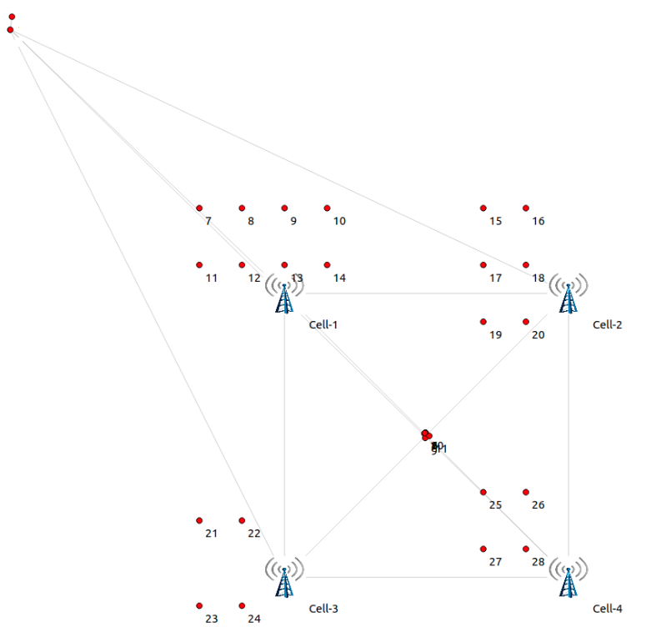
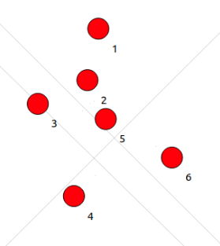
NS-3 LTE Simulation Scenario
Server
SGW/PGW
Stationary Users
Stationary Users
Mobile Users
Mobile Users
Stationary Users
Stationary Users

Slide 5
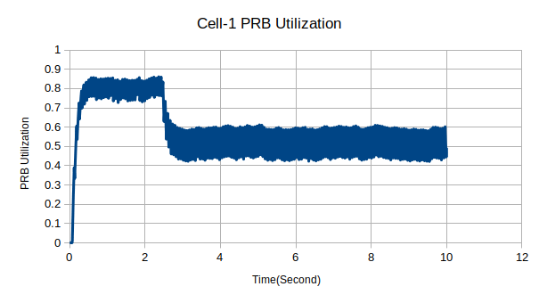
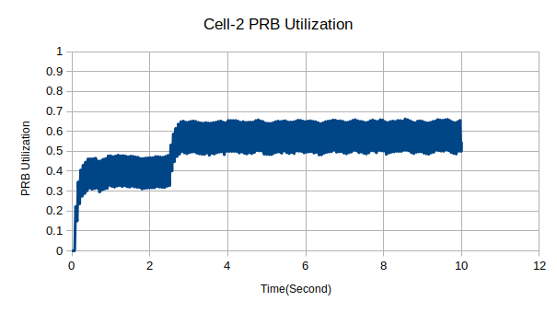
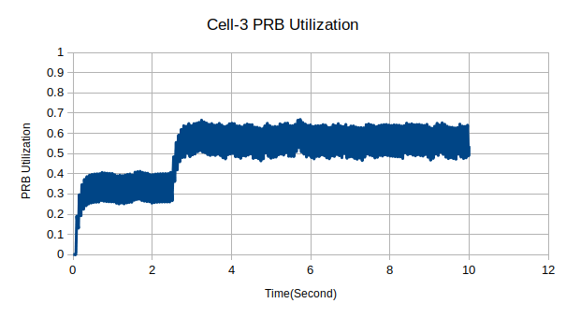
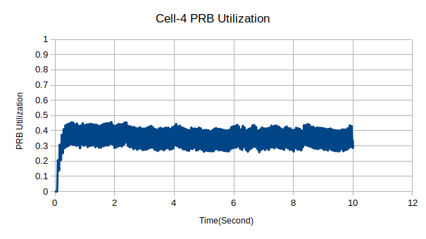
Cell Loading Vs. Time
Handovers
Handovers
Handovers

Slide 6
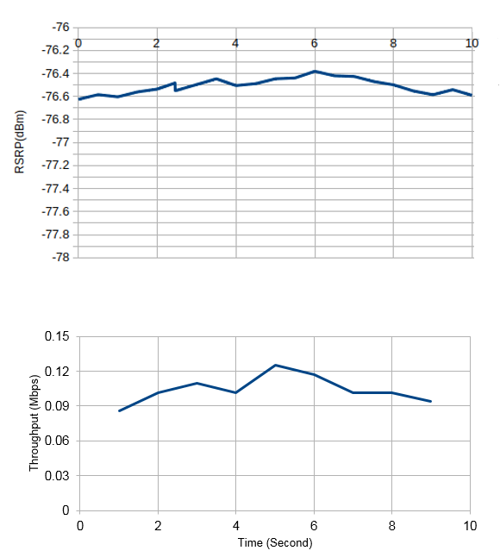
Metrics for a User Undergoing MLB Handover
Serving Cell Signal Strength (RSRP)
Observations:
Signal strength may not suffer significantly.
Likely to get better performance.
Induces network-wide fairness.
Throughput (Averaged over past 1 Second)
Handover

Slide 7
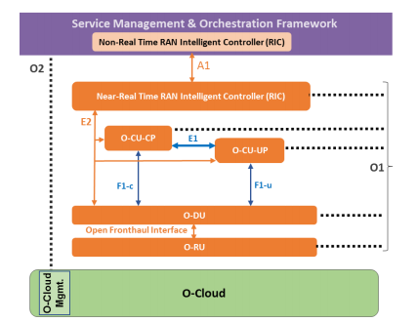
Desirable Features for NS-3
More accurate LTE/5G schedulers with easy access to performance metrics (e.g., cell loading).
Modeling of O-RAN based architecture for 5G.
Near-Real-Time and Non-Real-Time RAN Intelligent Controllers (RICs).
5G Base Station split options for Remote Unit (RU), Distributed Unit (DU) & Centralized Unit (CU) disaggregation.

